Slide 1
Nankai Trough 2D seismic line processing

Slide 2
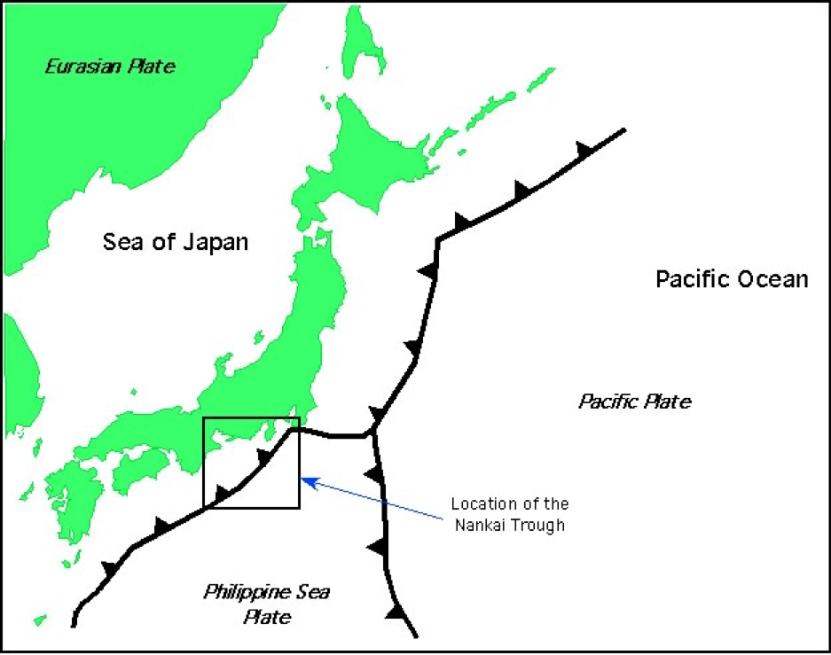
Location
- Nankai Trough
-900 km S Japan
- The Shikoku Basin
- Relatively shallow trench.
Notes:
- Nankai Trough is located about 900 km south of Japan coast, where the Philippines plate is subducting beneath Eurasia.
- The Shikoku Basin section of the northern Philippine Sea plate has been subducting northwestward under southern Japan along the Nankai Trough.
- The Nankai Trough is a relatively shallow trench. The decollement is near the top of the Shikoku Basin lower unit.

Slide 3
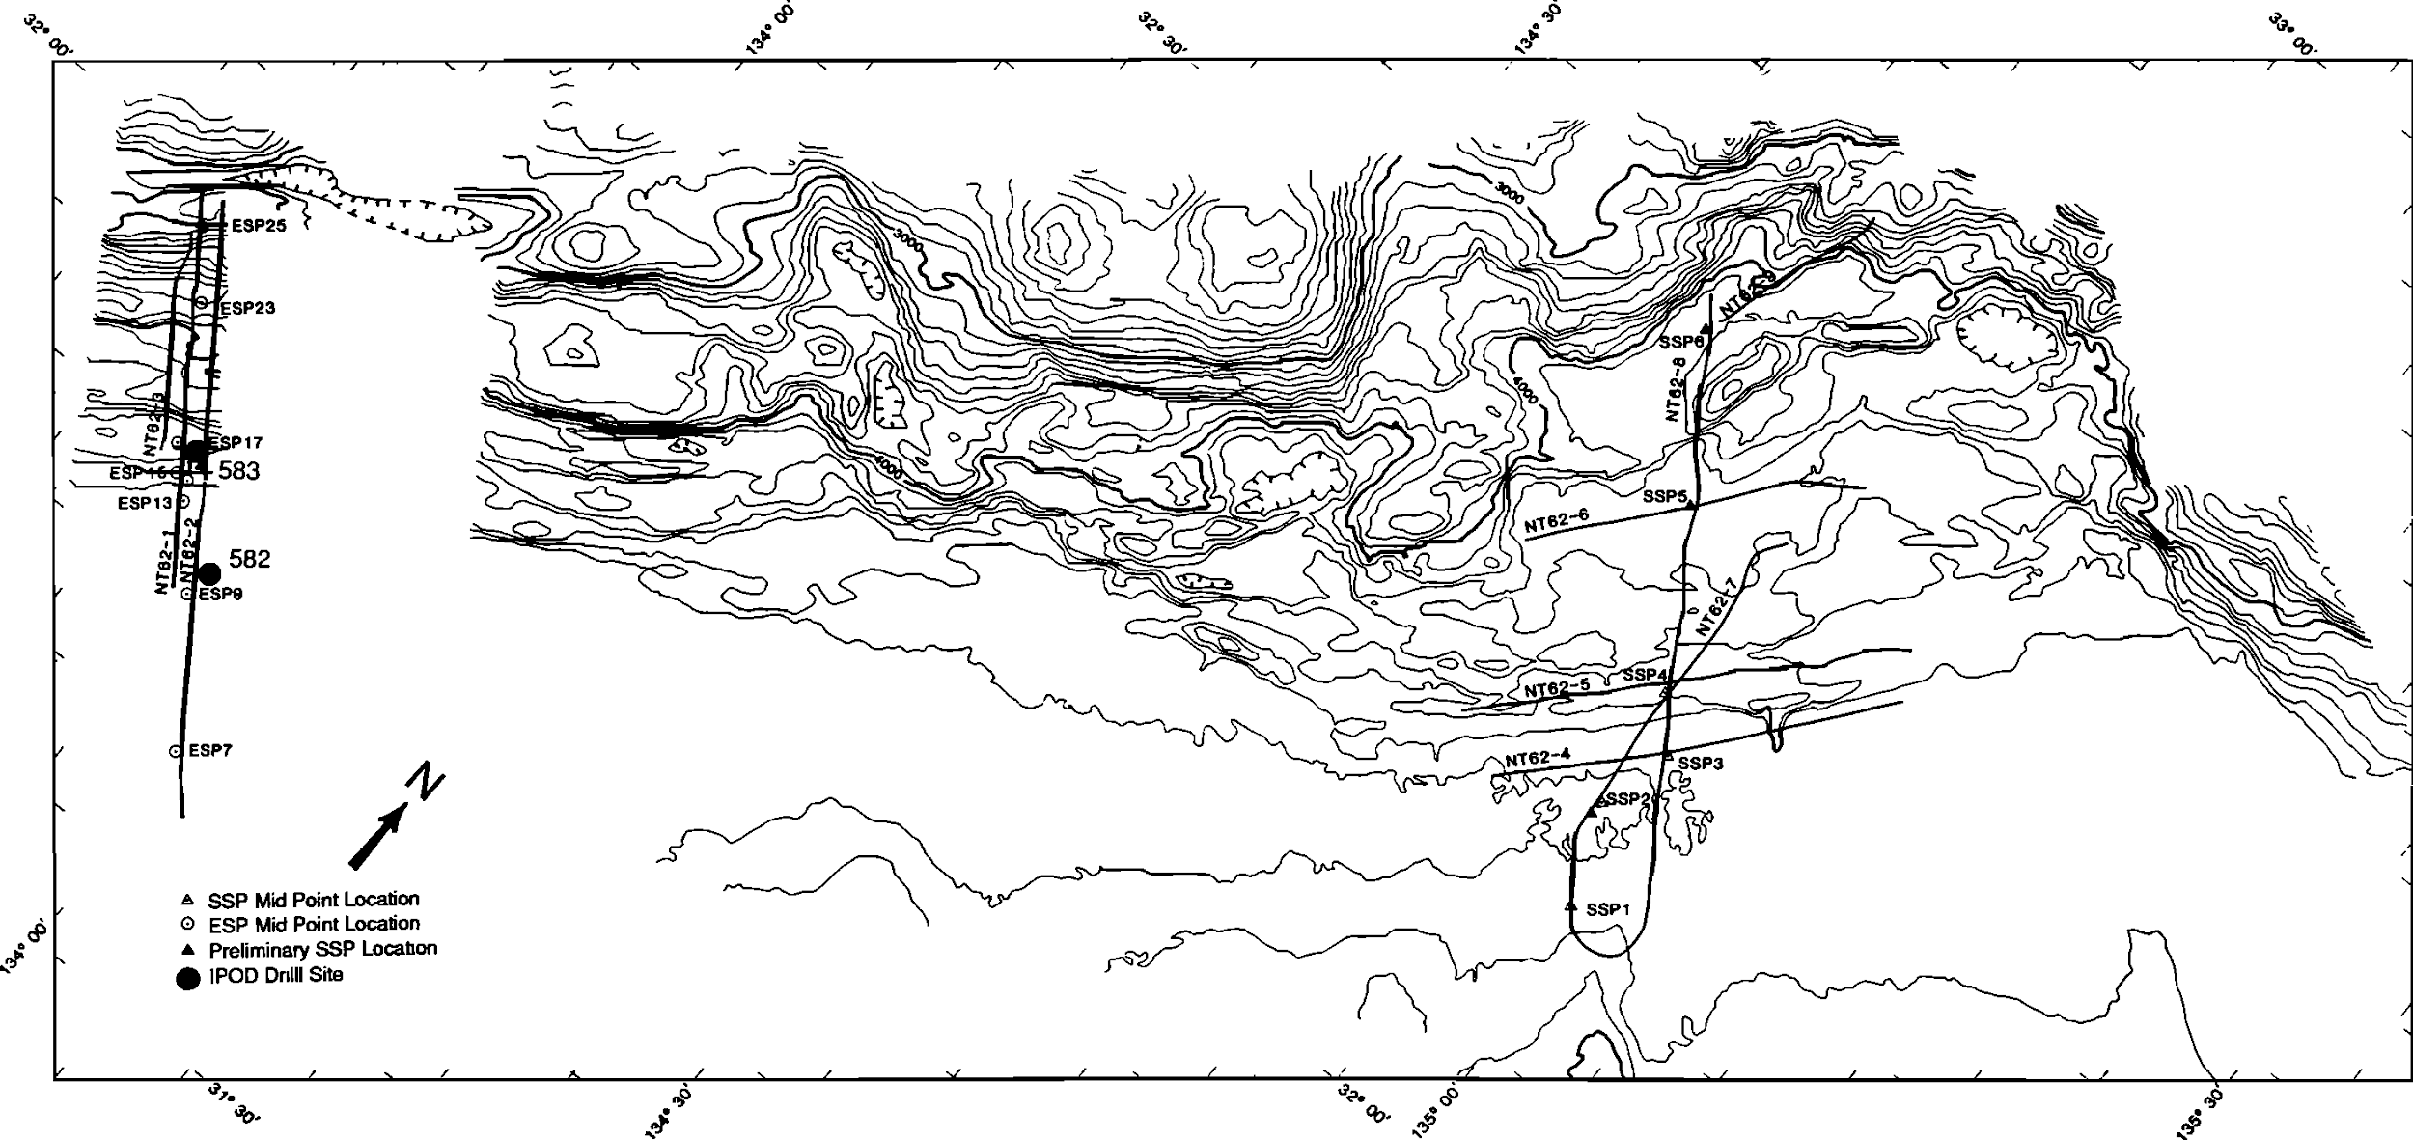
Seismic acquisition
- The data were collected by the University of Texas and the University of Tokyo.
- High-resolution multichannel seismic.
- Sources: Tuned array of 6 air guns.
- Receivers: Analog hydrophone streamer.
- Field data were sorted into 16.66-m bins.
Notes:
- The data were collected by the University of Texas, the University of Tulsa, and the University of Tokyo.
- 250 km of 96-channel, high-resolution multichannel seismic reflection profiles
- Sources: Tuned array of 6 air guns. Receivers: Analog hydrophone streamer with 68 channels at 33.33-m group interval.
- Field data were sorted into 16.66-m bins.

Slide 4
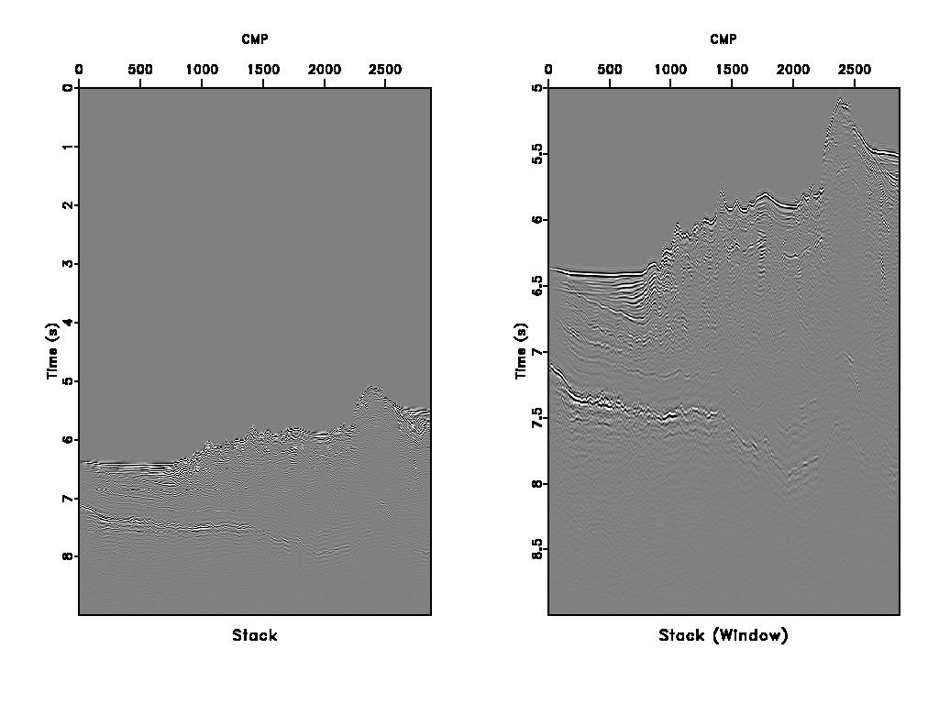
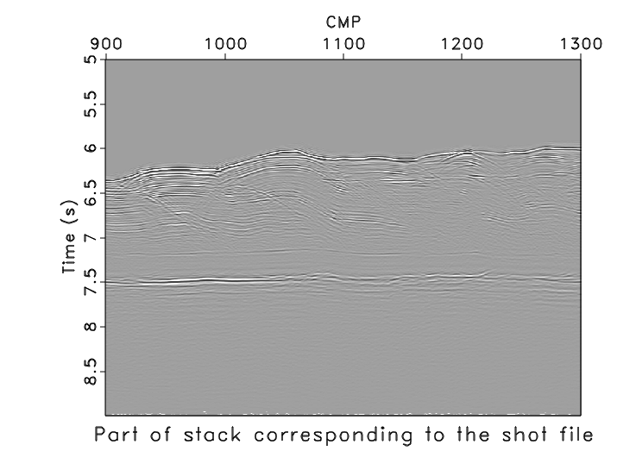
Published migrated stack
Notes:
TWT ~6.5 seconds and using 1500 m/s for water velocity, depth of ~4.5 km
Trench around CMP 0-1000
Diffractions not collapsed; accretionary prisms w/ distorted sediments that cause the seen topo

Slide 5
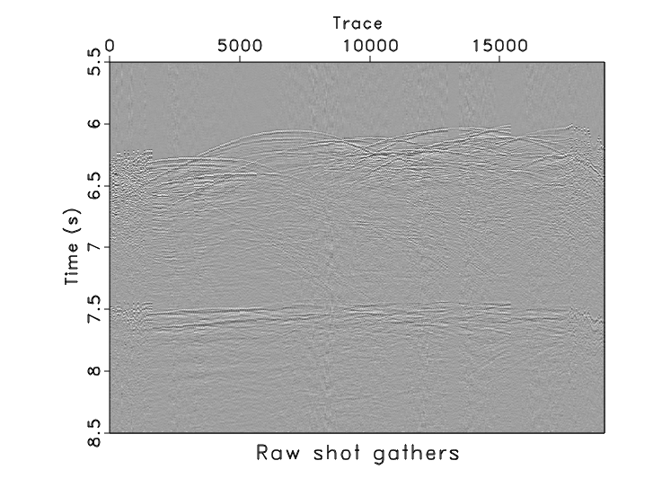
Shot gathers first look
- 326 shot gathers with 19057 traces. Total time sample is 11 seconds with interval 0.002 seconds.
- The published stacked data has 2250 traces with total time length of 9 seconds and 0.004 seconds sample interval.
- The shot-gather data has 401 CMPs while the stacked data has 2869 CMPs.

Slide 6
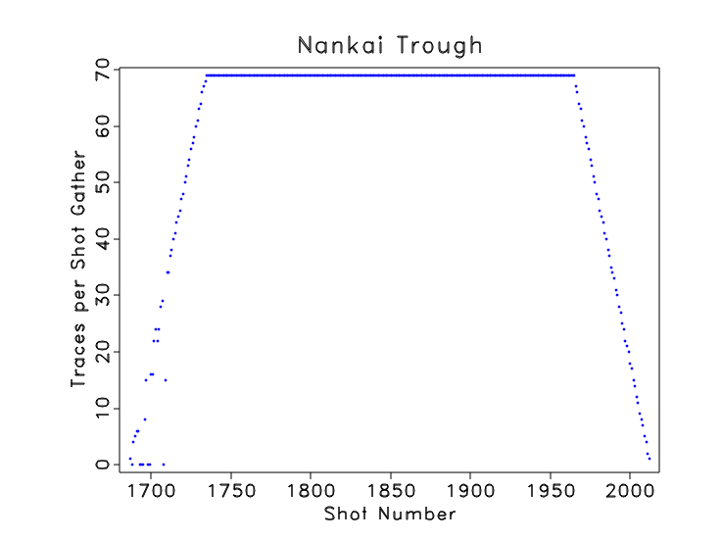
Shot gathers first look
- The first shot gather has one trace. The number of traces per gather increases to a maximum of 69 at gather 1735.
- The number of traces per gather keeps constant through gather 1965 and decreases to 1 at the last gather 2012.
- There are missing traces at some shot gathers.

Slide 7
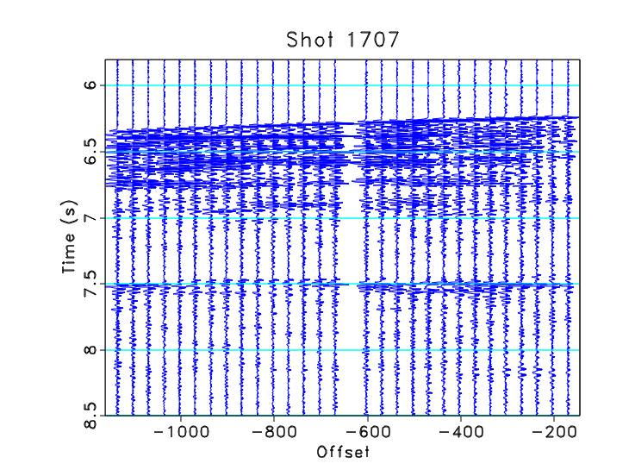

Slide 8
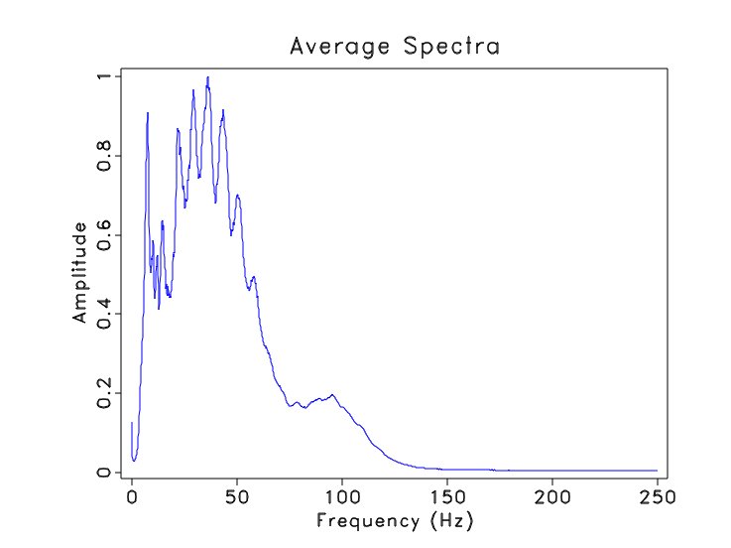
Shot gathers first look
- Low frequencies smaller than 10 Hz need to be filtered.
- The data was resampled to 4 ms sample interval later so high frequencies above 125 Hz need to be filtered to prevent aliasing and remove noise.

Slide 9
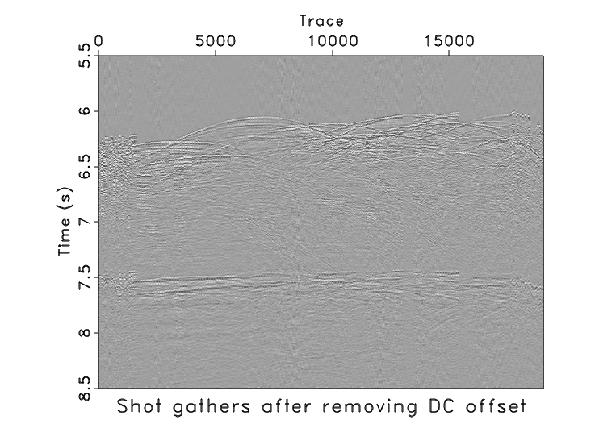
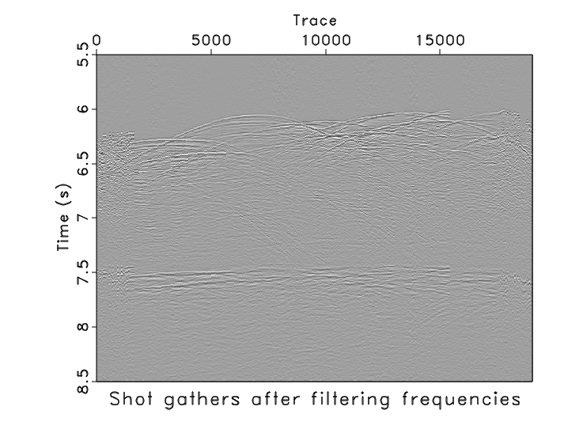
Surface-consistent amplitude balancing

Slide 10
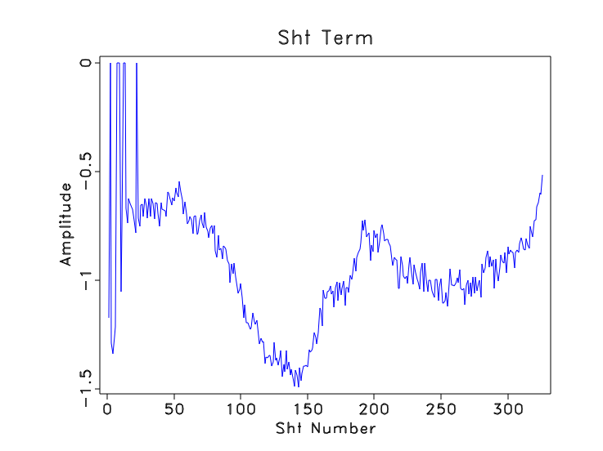
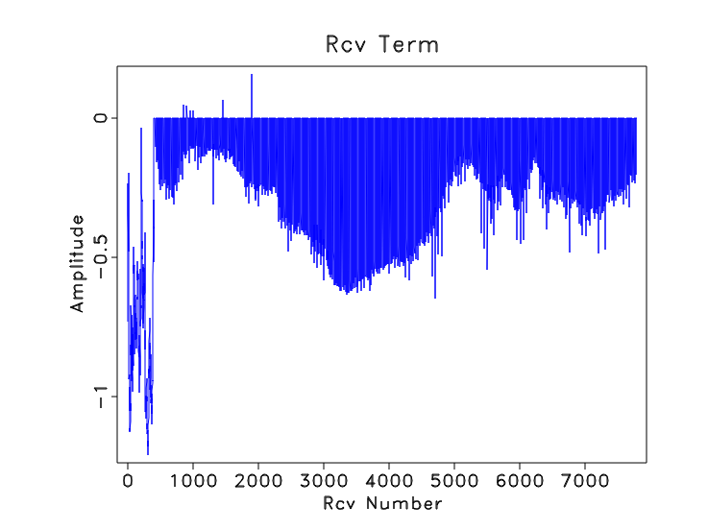
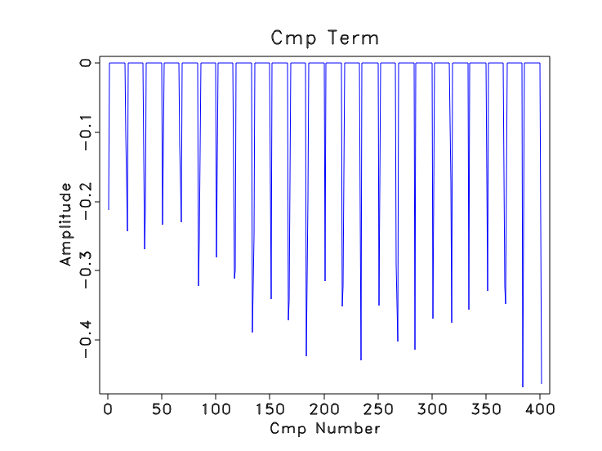
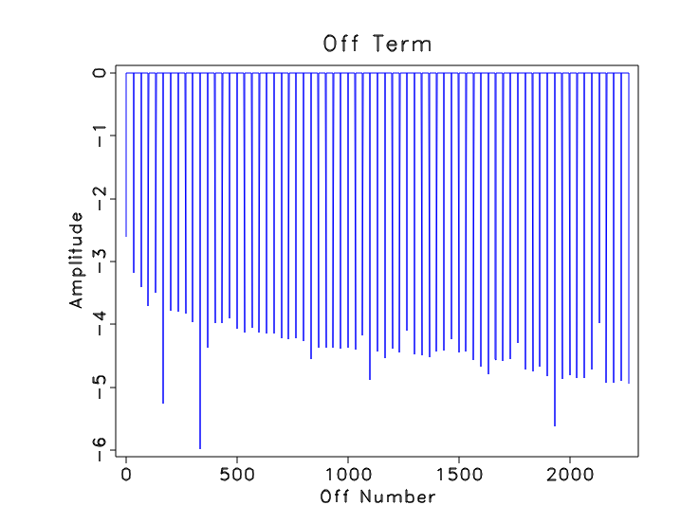

Slide 11
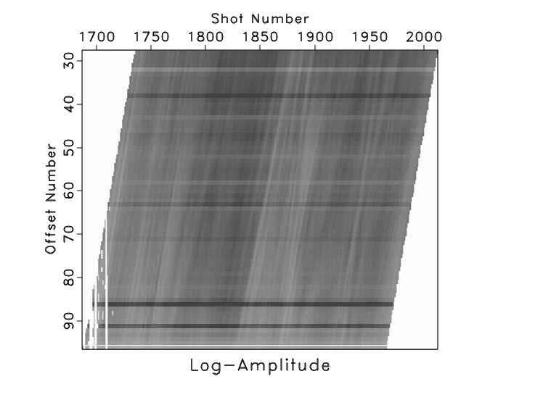

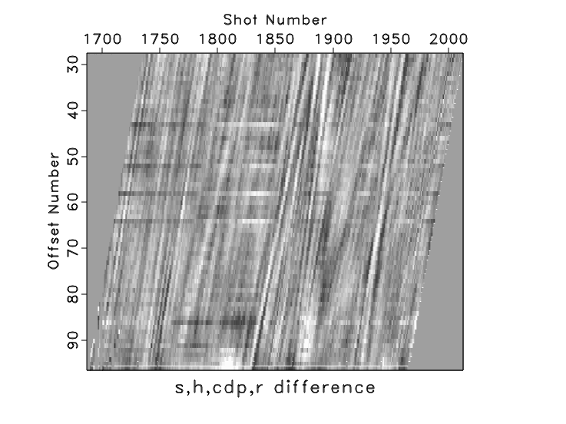
Surface-consistent amplitude balancing
- Zero traces were removed. The surface-consistent model tries to explain the trace amplitude using a product of source, receiver, offset, and midpoint factors.
- The horizontal stripes come from the offset term. The vertical stripes come from the shot term. The diagonal stripes come from the CMP and receiver terms.

Slide 12
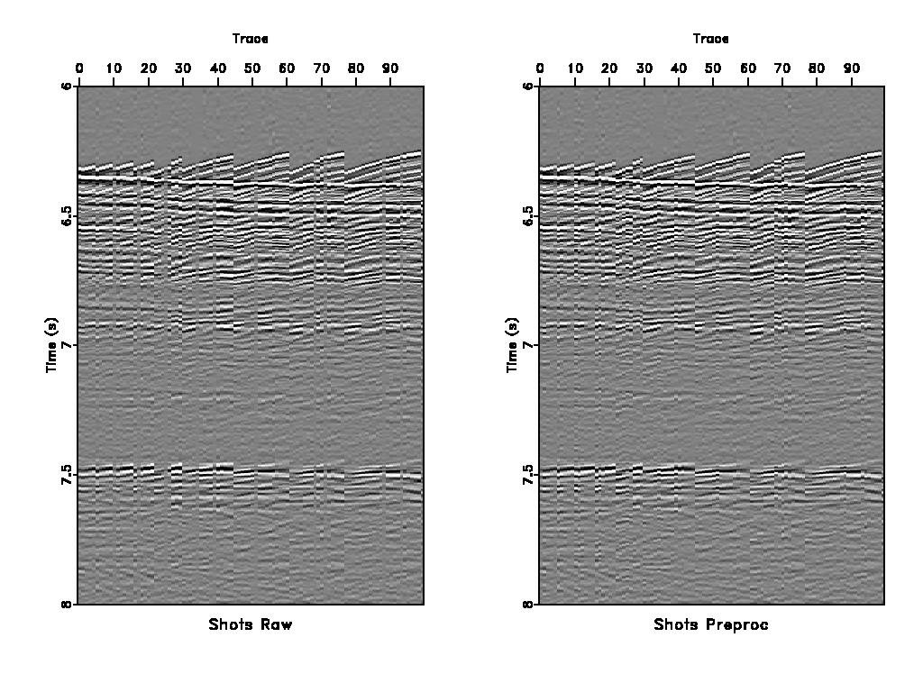
Surface-consistent amplitude balancing

Slide 13
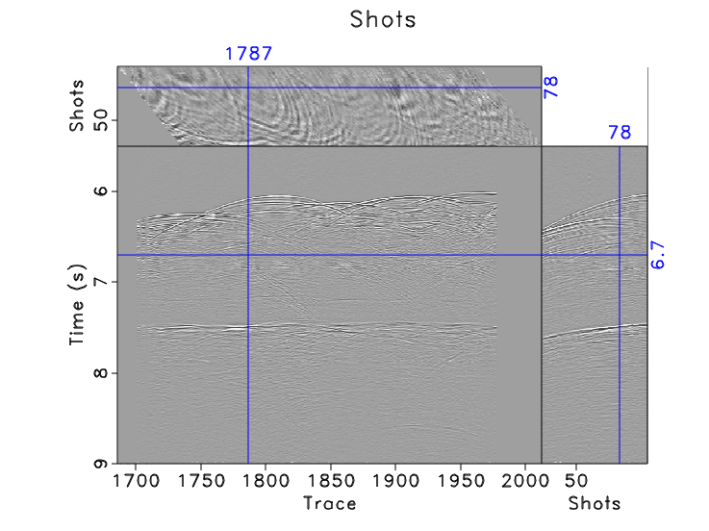
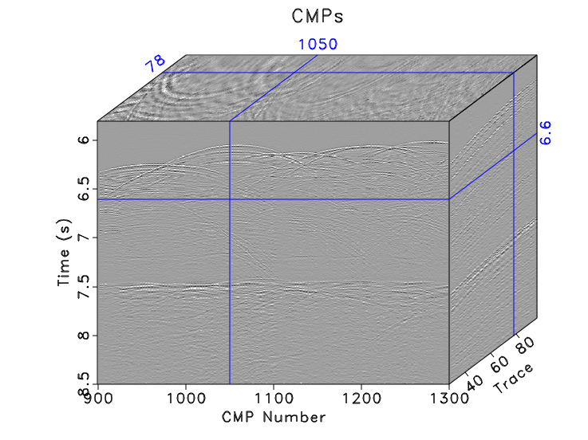
CMP sorting

Slide 14
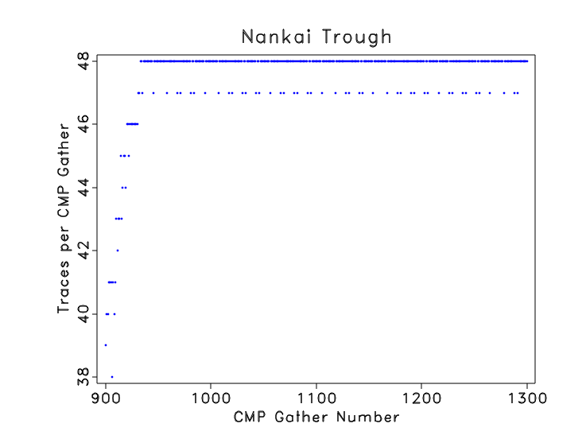
Fold distribution
- First CMPs are not full fold.
- The first full-fold CMP gather is CMP 933 with 48 traces.

Slide 15
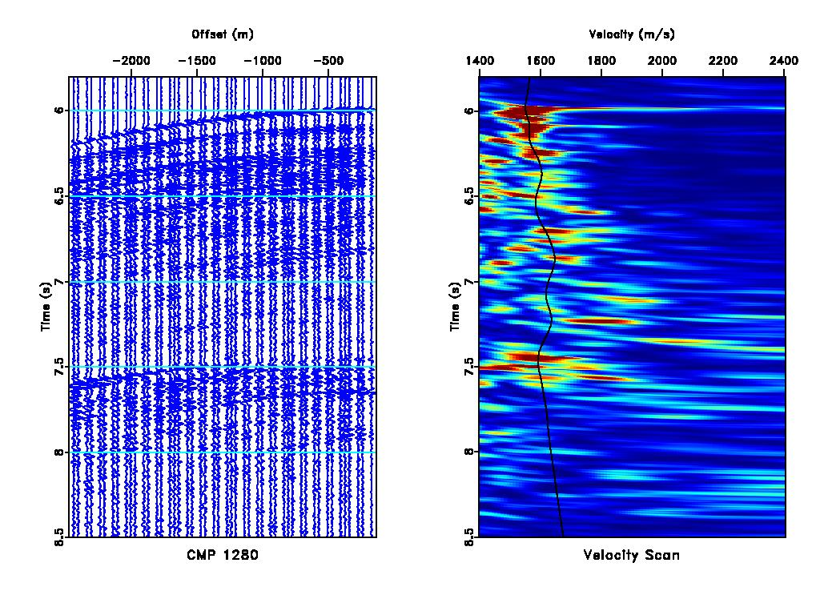
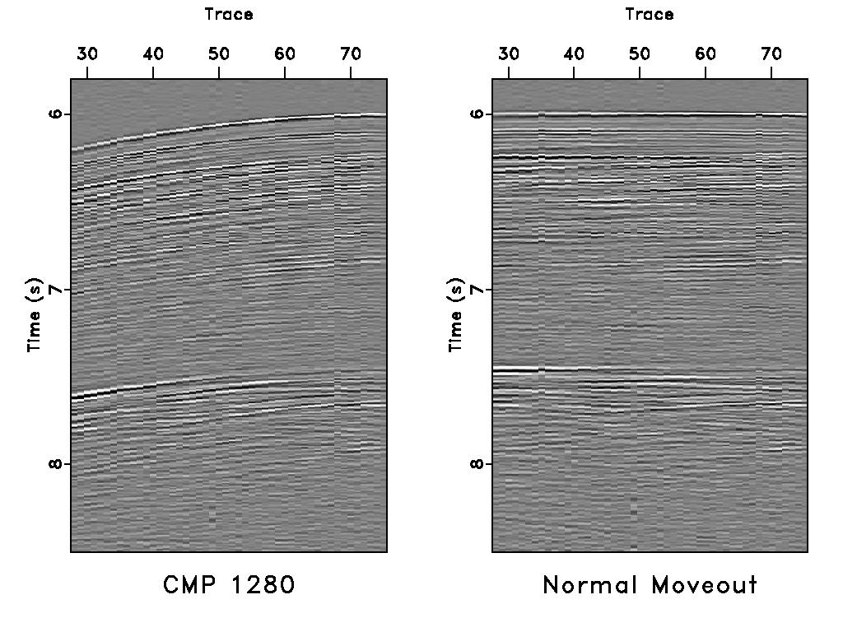
Velocity analysis and NMO

Slide 16
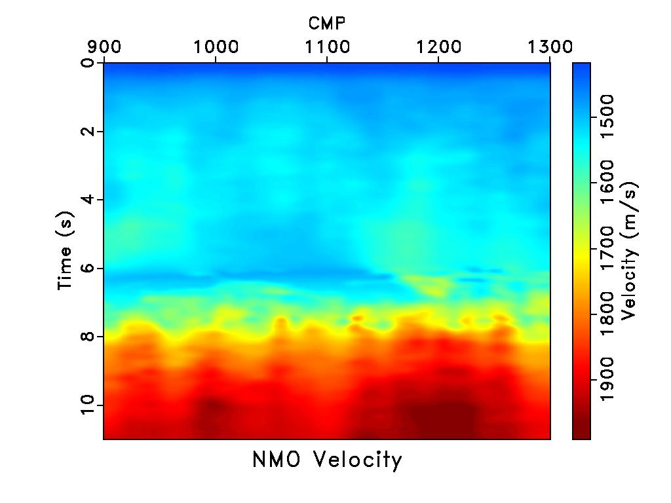
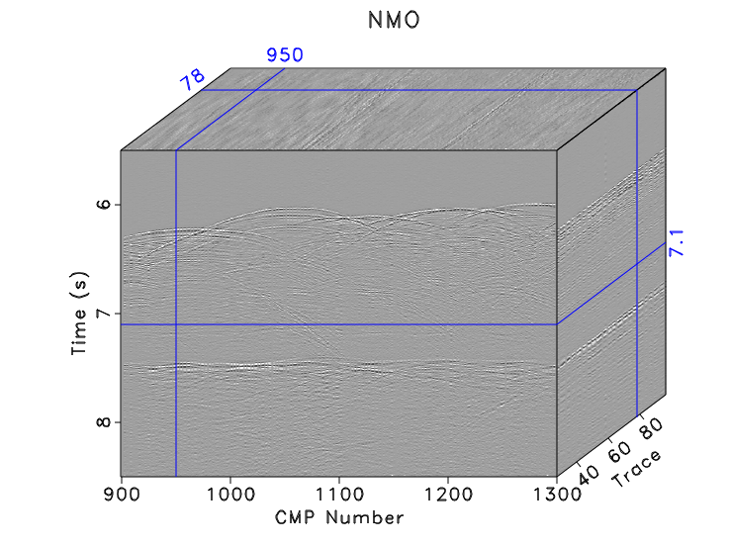
Velocity analysis and NMO

Slide 17
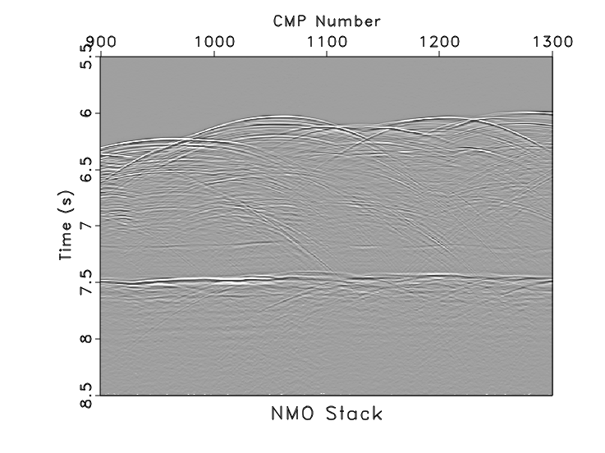
Stack

Slide 18
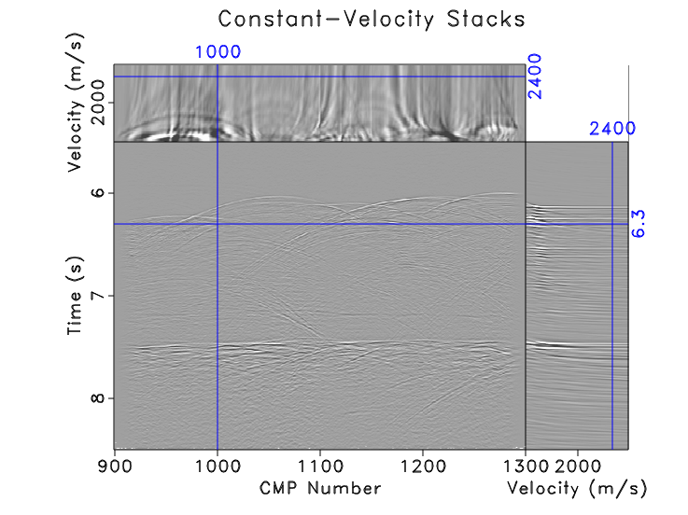
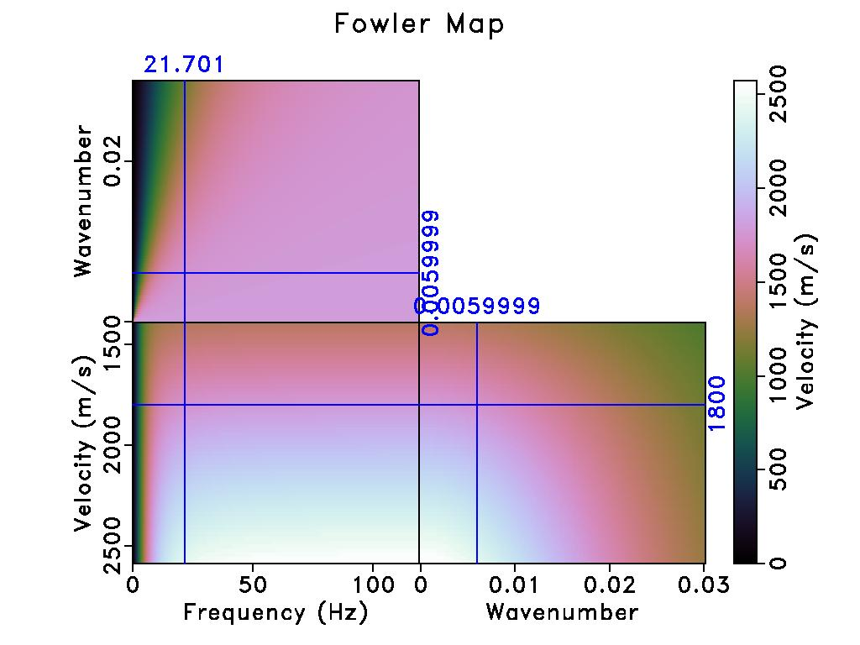
DMO

Slide 19
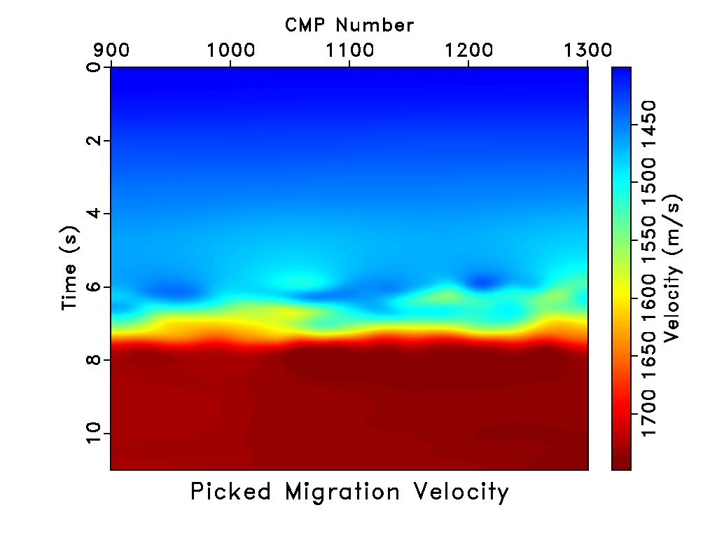
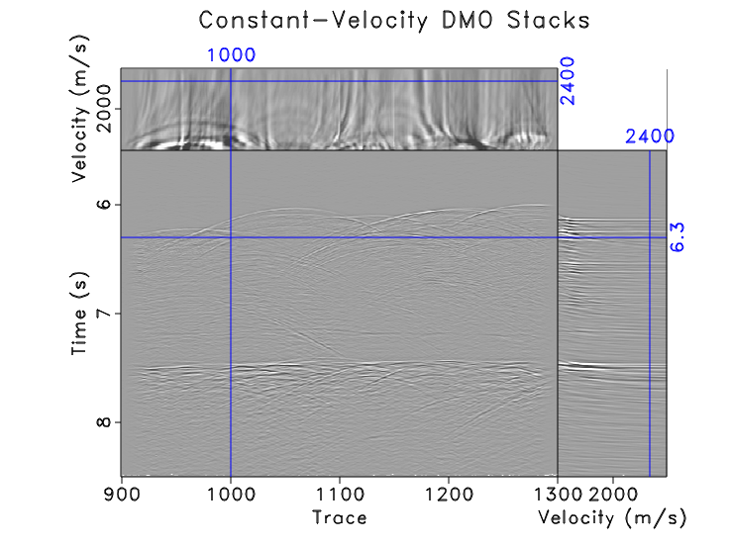
DMO

Slide 20
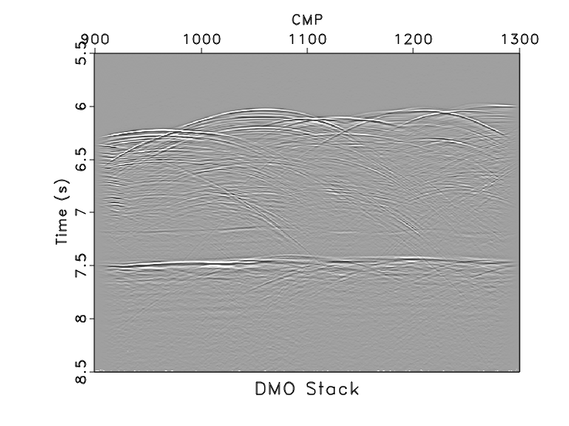
DMO
- DMO stack corrects for dips.
- Generated from an ensemble stack of different velocities.
- DMO velocities were picked automatically from the envelope.

Slide 21
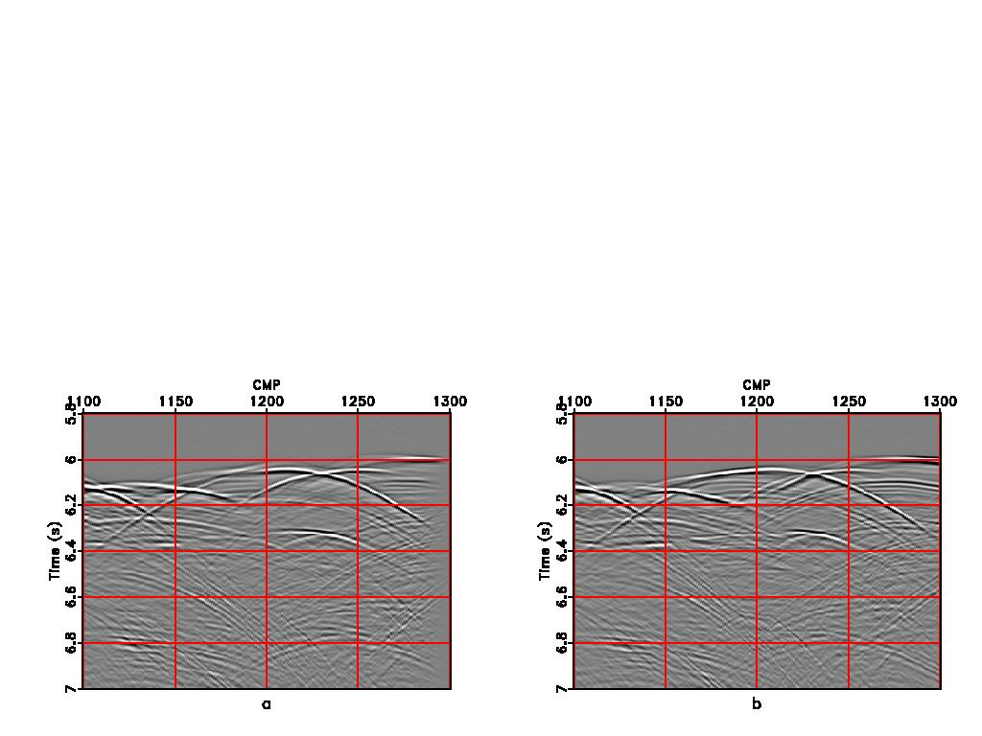
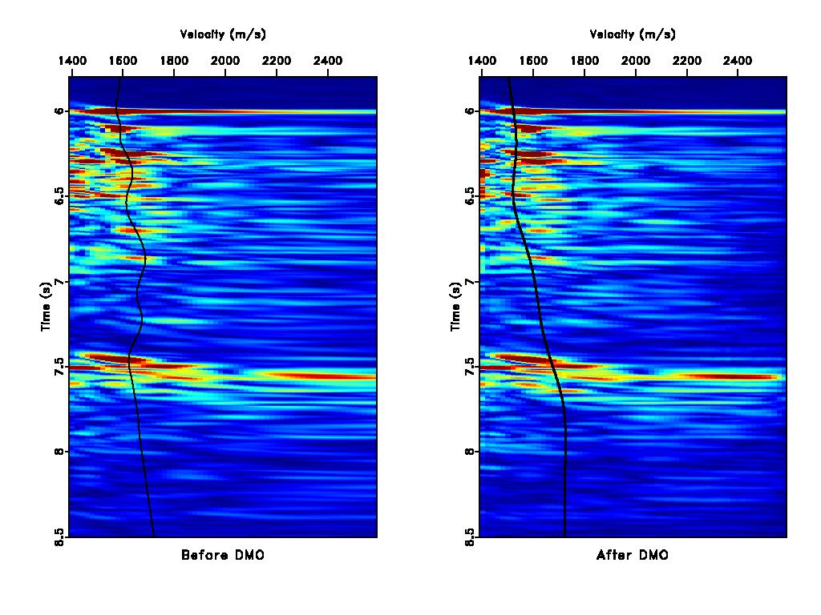
DMO
DMO
NMO
- Velocities are corrected for dips.
- Picked velocities are smoother and increase with depth.
- Events are clearer in DMO stack.

Slide 22
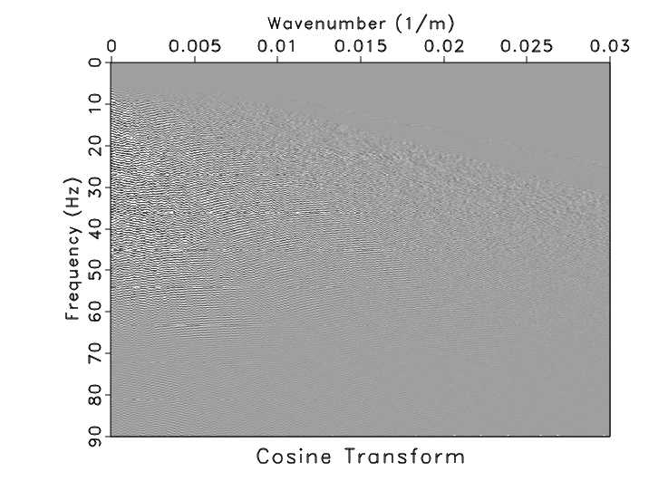
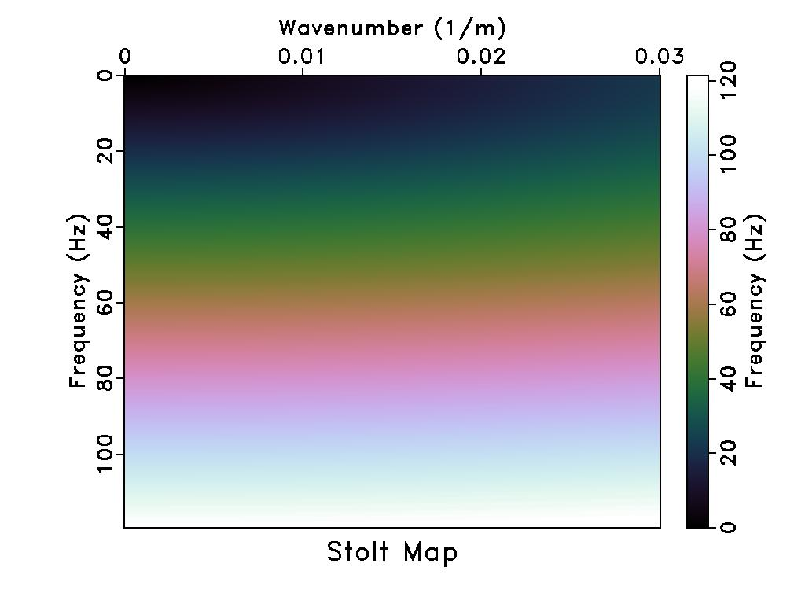
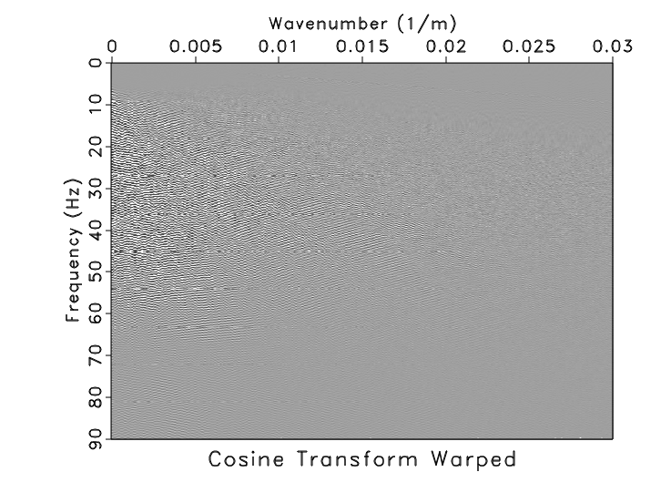
Stolt migration constant velocity

Slide 23
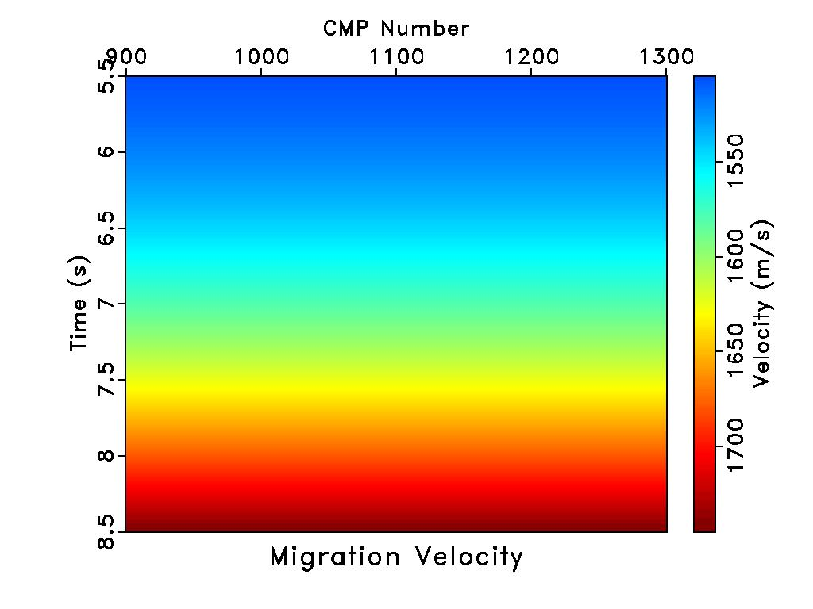
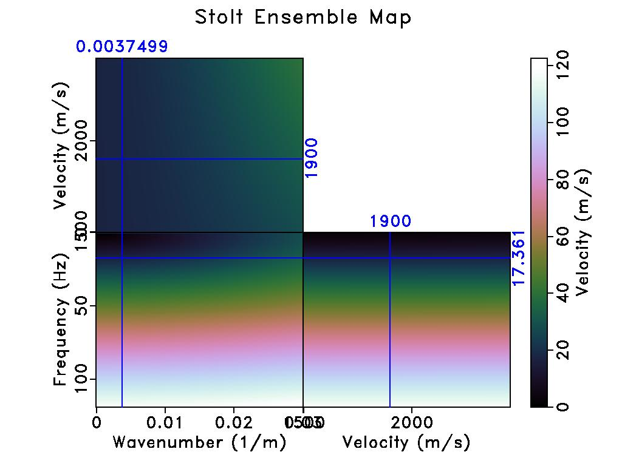
Stolt migration variable velocity
- More realistic velocity distribution.

Slide 24
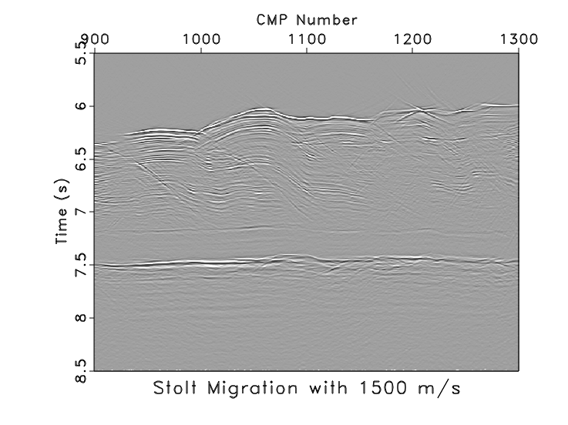
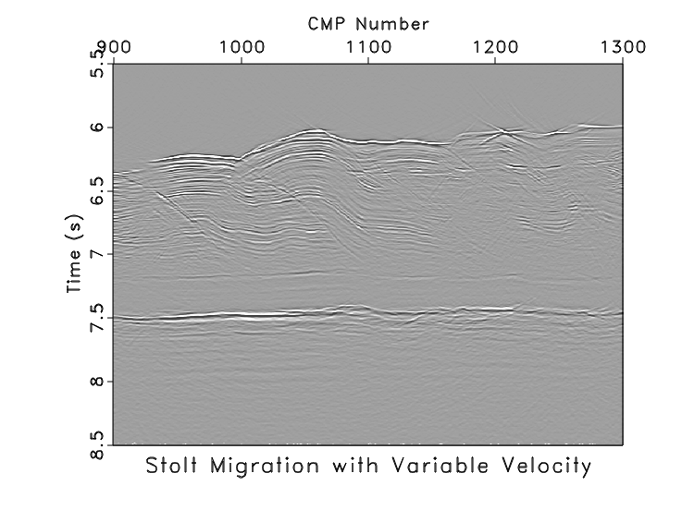
Stolt migration

Slide 25
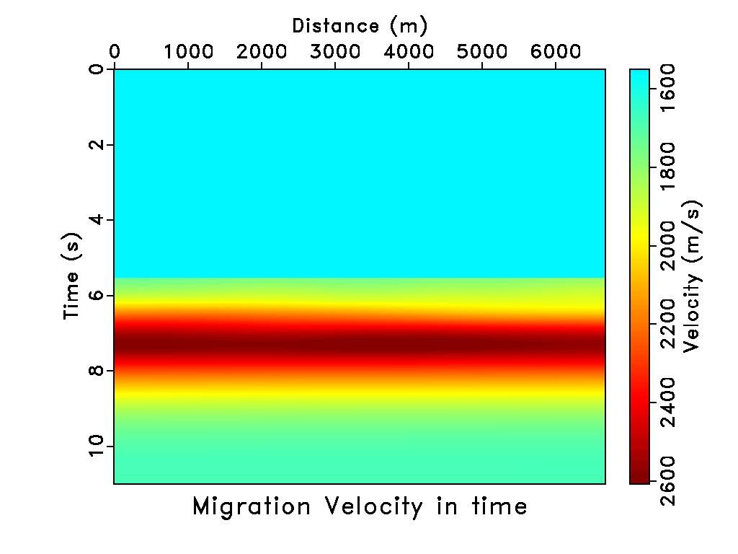
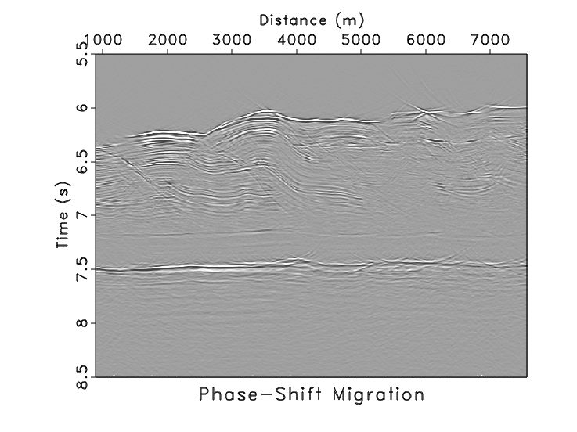
Gazdag migration

Slide 26
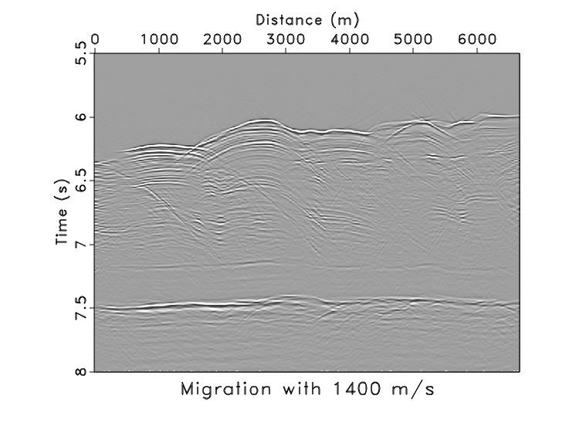
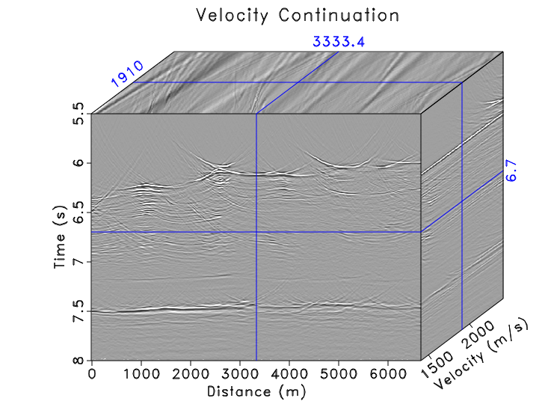
Velocity continuation

Slide 27
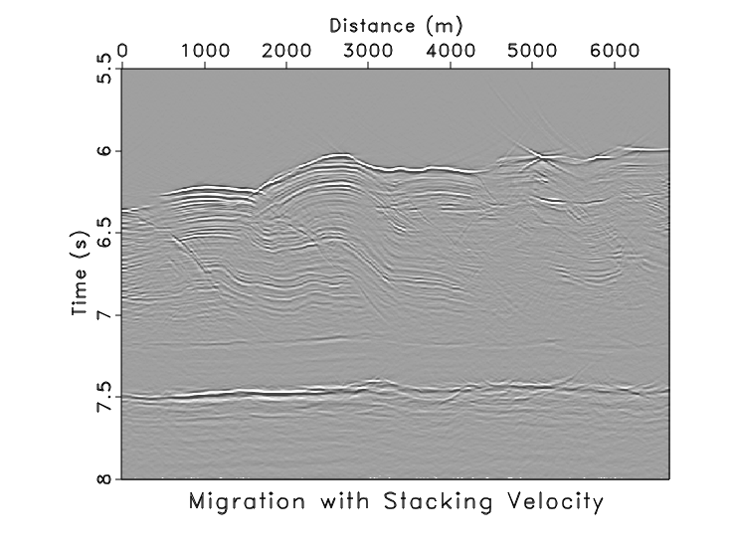
Velocity continuation

Slide 28
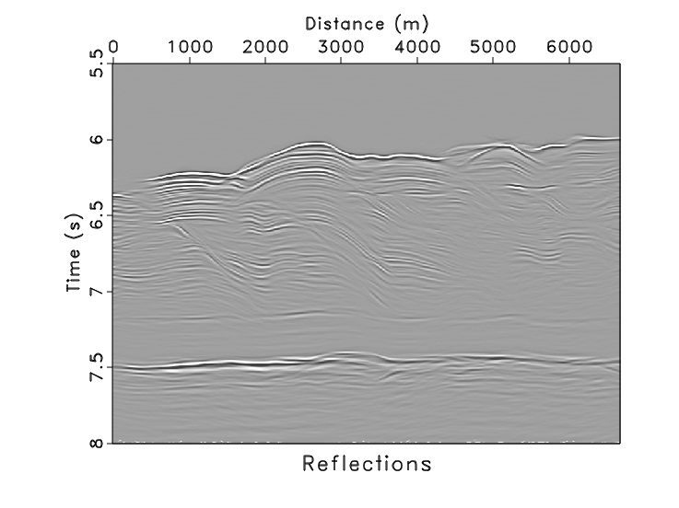
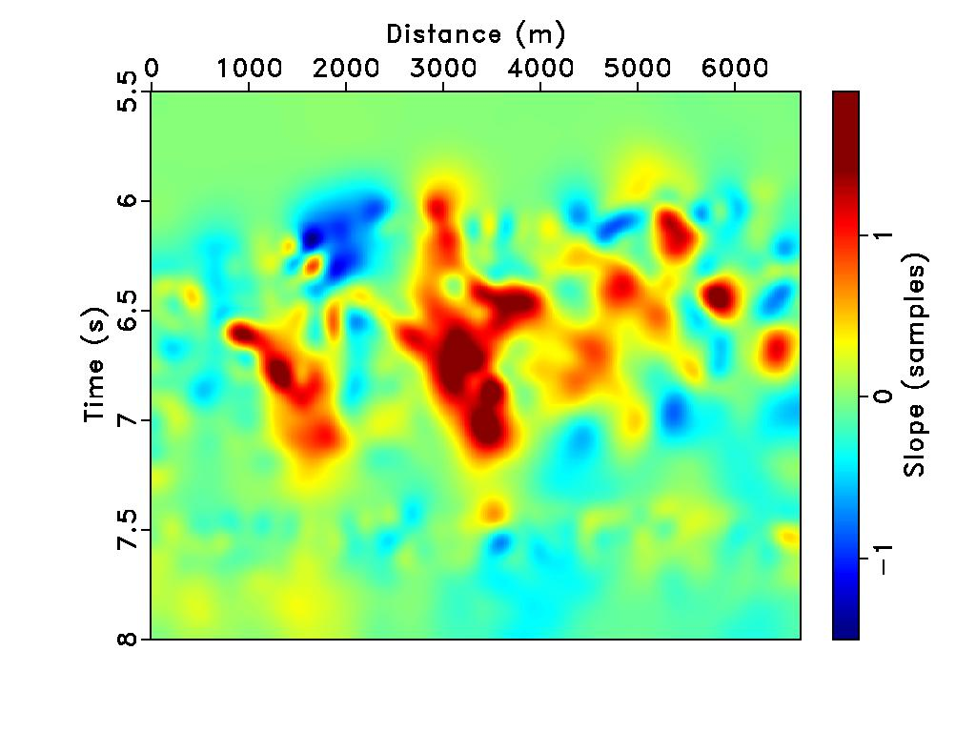
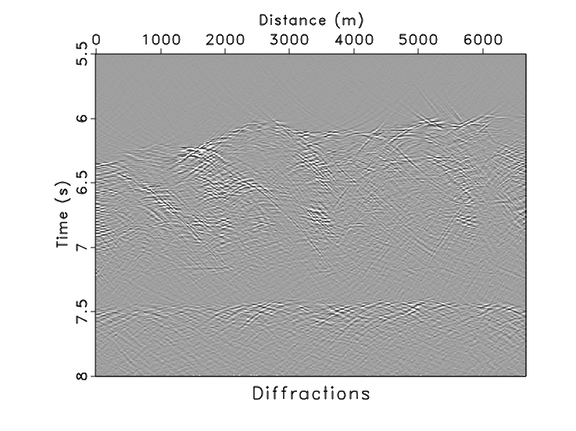
Velocity continuation

Slide 29
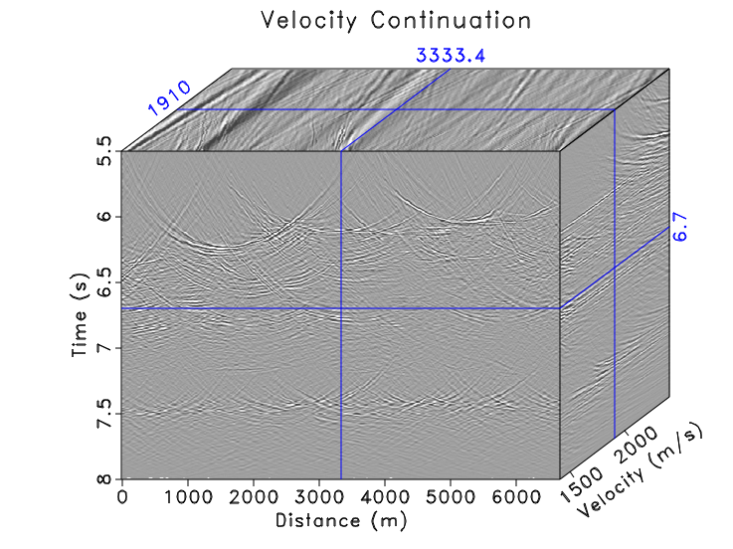
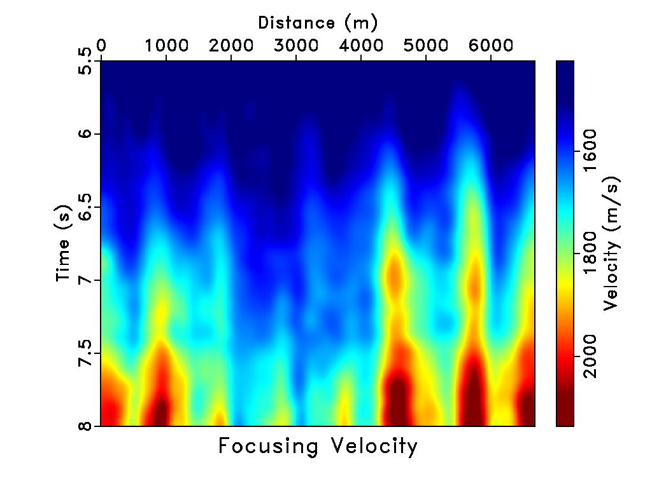
Velocity continuation

Slide 30
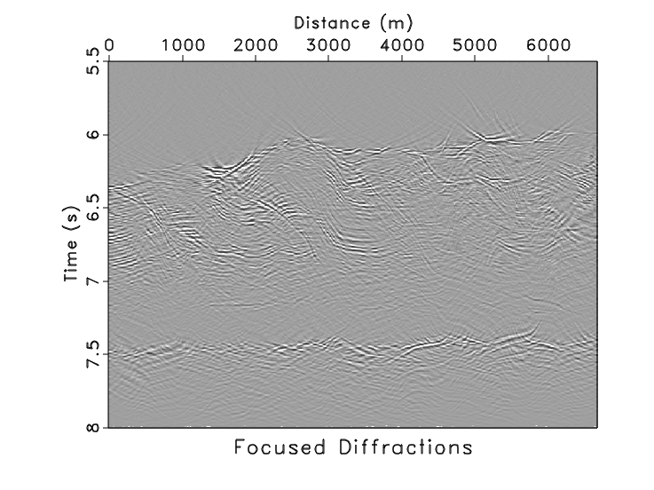

Velocity continuation

Slide 31


Reverse-time migration

Slide 32


Split-step migration

Slide 33



Migration comparison

Slide 34


Migration comparison

Slide 35





Slide 36

Interpretations
Notes:
3 Sections or packages: Shikoku Basin comprised of upper and lower (~5000-6000m; 6000-6500m) and basement at ~6500m
Decollement is in the reflection free/transparent portion (homogenous unit) of the lower unit of the Shikoku Basin

Slide 37
Conclusions
- Nankai data has many diffractions.
- The reflectors are generally flat geology.
- We processed from raw data to surface-consistent amplitude balancing, CMP sorting, velocity analysis, NMO, DMO, stack, and migration. The result can be used for interpretations.
- We improved the quality of the published migrated image by doing more detailed velocity analysis in migration to collapse the diffractions.

Slide 38



Migration comparison

Slide 39


Migration comparison

Slide 40





